Slide 1

Course Administration
The best way to contact TA is wechat group, but emails are always welcome!

Slide 2
Computer Architecture Fall 2024 Lecture 01: Introduction
Jie Zhang
jiez@pku.edu.cn
Notes:
跟ICS课的区别；
英文材料，中文授课；
退选课；

Slide 3
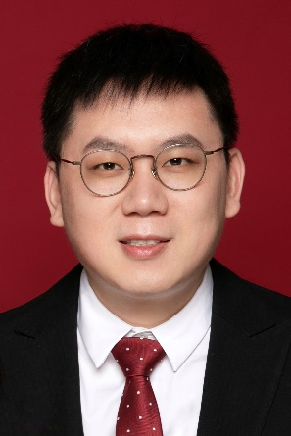
Course Administration
Jie Zhang (Instructor)
Office: Yanyuan Building #508
Email: jiez@pku.edu.cn
Wechat/Phone: 19910031394

Slide 4
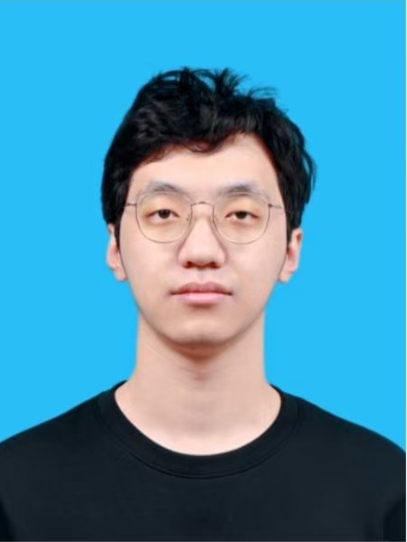
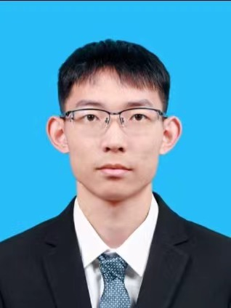
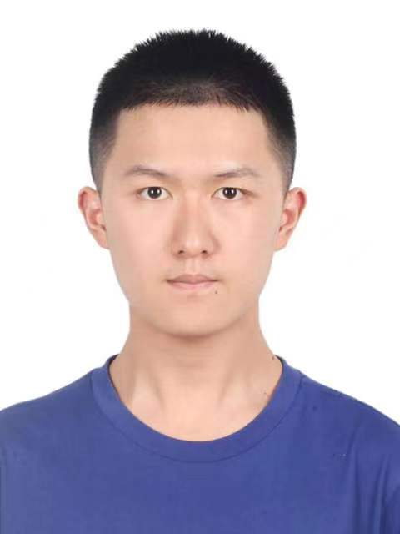
Course Administration
Yuda An (TA)
Office:
Yanyuan Building #508
Email:
2401111987@stu.pku.edu.cn
Office hours:
Friday (1:00 ~ 5:00 PM)
Shaocong Sun (TA)
Office:
Yanyuan Building #508
Email:
2401112042@stu.pku.edu.cn
Office hours:
Friday (1:00 ~ 5:00 PM)
Guoci Chen (TA)
Office:
Yanyuan Building #508
Email:
gcc314@stu.pku.edu.cn
Office hours:
Friday (1:00 ~ 5:00 PM)
Credit bonus for 10 most frequently-attend students

Slide 5
Who Am I?
Jie Zhang
Ph.D. advisor, Boya Young Scholar, NSFC Excellent Overseas Young Scientists Fund, Intel Young Faculty Research Program, ACM SIGCSE Rising Star Award
Assistant Professor, Peking University
KAIST, South Korea, Postdoctoral Researcher in Computer Science
Yonsei University, South Korea, Ph.D. in Computer Science
Web: https://chaselab.wiki/

Slide 6











CHASE Lab
Research:
Computer architecture
Storage and memory systems
Members:
Shushu Yi (Ph.D., graduated from Nanjing University)
Xiurui Pan (Ph.D., graduated from Tsinghua University)
Li Peng (Ph.D., graduated from HUST)
Yuda An, Shaocong Sun (Ph.D., graduated from Peking University)
Research collaborators
Notes:
五道口理工学院、武汉某和尚院校

Slide 7





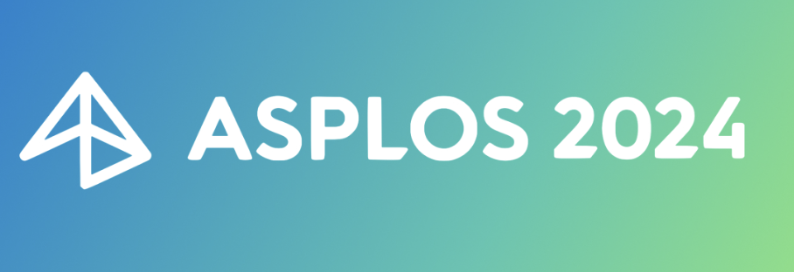
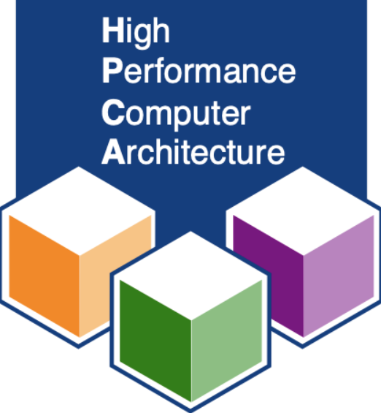


We are growing in arch and system research
ISCA 2024
ISCA 2021
20
MICRO 2024

Slide 8
We are hiring
If you are interested in CA, storage or research,
please send your information to
jiez@pku.edu.cn

Slide 9
Course Logistics

Slide 10
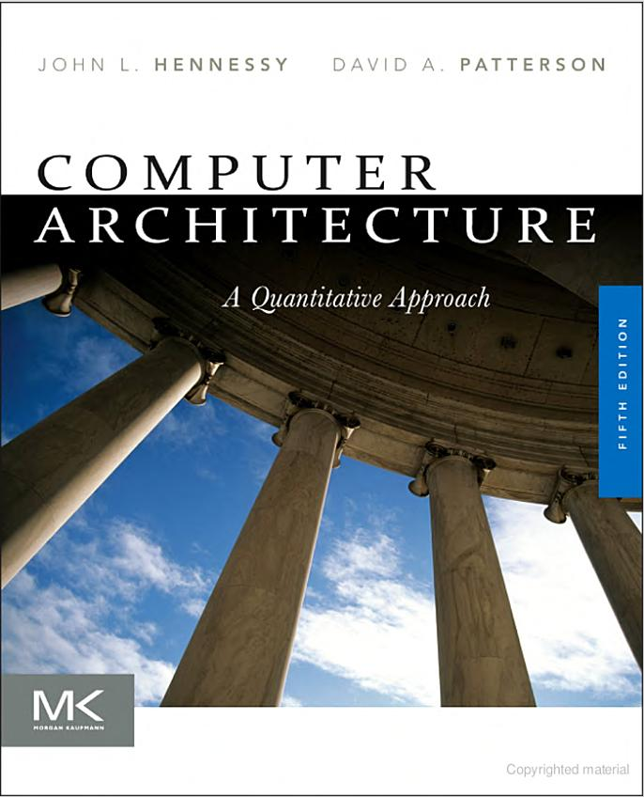
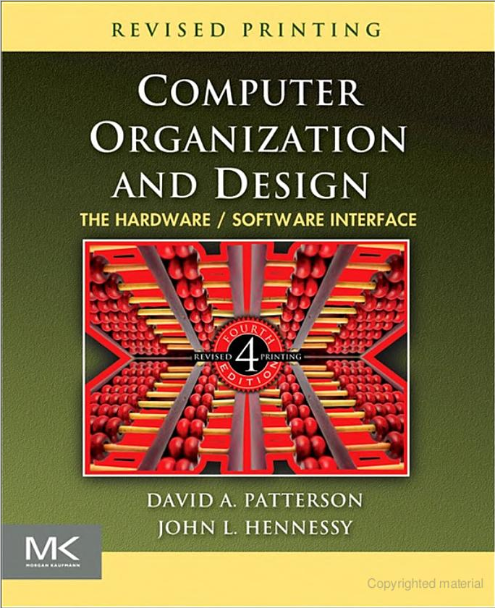
Bibles in Computer Architecture
VS.

Slide 11
Bibles in Computer Architecture
H&P
Quantitative Design and Analysis
Memory Hierarchy Design
Instruction-level Parallelism
Data-level Parallelism
Thread-level Parallelism
P&H
Computer Abstraction
Basics of Instruction
Arithmetic for Computers
The Processor
Storage Concept
Multicore, Multiprocessor, and Clusters
VS.

Slide 12
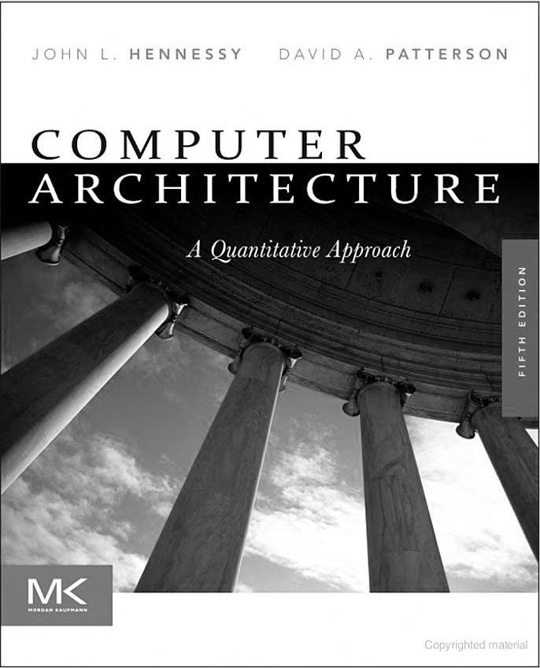
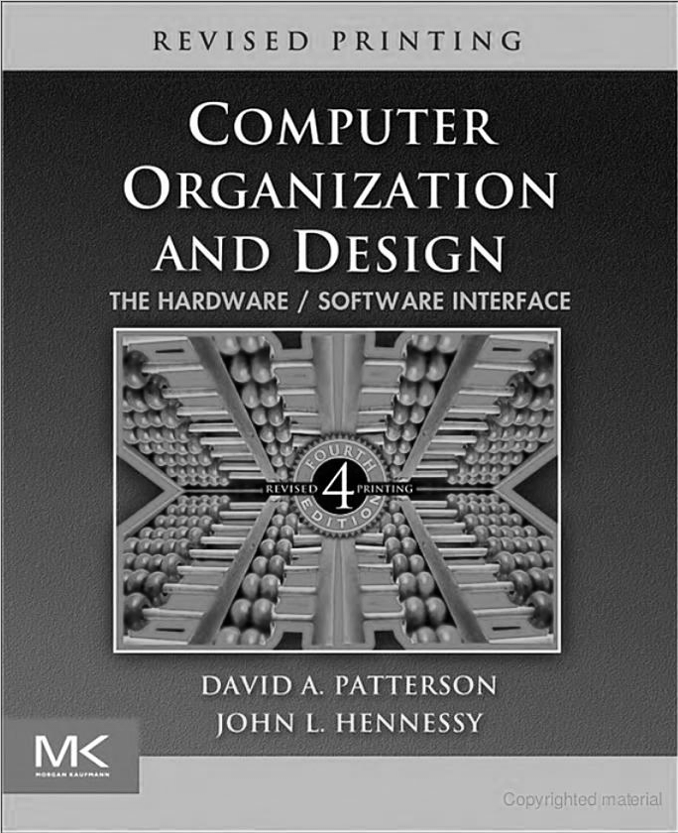
Bibles in Computer Architecture
“A little bit”
Advanced Topics
VS.
Conceptual Idea
6th edition
RISC V edition

Slide 13
Grading Information
Grade determinates
Final Exam ~35%
Jan. 9, 2024 and Location (TBD)
Project ~45%
Class participation (pre.) & pop quizzes ~15%
(no homework, but be prepared)
Paper review ~10%
Impression (help me learn your name) ~3%
Office hour attendance ~2%
Will announce in class if there are any updates

Slide 14
Grading history
Grading information in 2023
[85,100] → 48%
[75, 85) → 32%

Slide 15
Course Structure
Lectures:
1 Overview @9.12
2 ISA & Arithmetic (Chapter 2&3, P&H) @9.19
3 Processor (Chapter 4, P&H) @9.26
4 Superscalar (Chapter 3.4 & 3.5, H&P) @10.10
5 Out of Order Execution (H&P) @10.17
6 Memory-1 (Chapter 5) @10.24
7 Memory-2 (Chapter 5), Lab-2 Review @10.31
8 Invited talk Security @11.7
9 NVM @11.14
10 Storage and SSDs -1@11.21
11 Storage and SSDs -2@11.28
12 Parallel Processor (Chapter 6) Lab-3 Review @12.5
13 Invited talk DSA @12.12
14 Invited talks GPU @12.19
15 Lab-4 & Course Review @12.26

Slide 16
Course Content
Basic Content
Principles of computer architecture:
CPU data-path and control unit design (pipelined, superscalar)
Memory hierarchies and design, I/O organization and interconnection
Parallel computing architecture design (multiprocessors, GPU, DSA)
Extra Content
Invited talks of hot topics:
Security, reliability, emerging technologies, etc.
Course goals
To show students the relationship between hardware and software and to focus on the concepts

Slide 17
Projects
Projects exist to help students in understanding simulation-based study popular in computer architecture field.
Individually performed
Late policy
You will be given 3 slip days, which can be used to extend project deadlines;
Example: 1 project extended by 3 days or 2 projects each extended by 1 days;
Projects are due at 11:59:59, no exceptions;
20% off per day late, 1 second late = 1 hour late = 1 day late;
Tips
Start early, start early and start early;
Projects are easy, but they take your time;

Slide 18
Project details
Simulation-based tasks
Get familiar with the popular simulator (gem5) in the computer architecture field;
Use gem5 to perform quantitative analysis;
Reproduce a few classic algorithms;
Outputs
Prepare a report for each lab (soft copy is preferred);
Source codes or video may be required by specific labs;

Slide 19


Project details
There exist four labs that guide you to learn how to use gem5 and perform experimental evaluations w/ system-call mode and full-system mode simulations
Lab #1 | Lab #2
1. Gem5 setup and CPU design analysis 2. Enabling full-system and multi-threading | 1. Performance analysis of branch predictors 2. Reproduce and evaluate a classic branch predictor, paper review
Lab #3 | Lab #4-optional
Cache design and optimizations Reproduce and evaluate a classic cache design, paper review | 1. Reproduce and evaluate a classic Flash Translation Mapping (FTL) scheme in SimpleSSD

Slide 20
Project details
Deadlines of the four labs are as follows:
Labs | Credit | Deadlines
Gem5 setup and system-call mode enabling | 10 | 10.8
Branch prediction | 15 | 11.5
Cache design | 15 | 12.17
FTL design | 5 | 1.21

Slide 21
Teaching style
3-hour lectures
– Breaks every hour. Other suggestions?
I have been working with systems for a long time, but I am experts of all aspects
– Things make sense to me may not make sense to you
– I talk fast if nobody stops me
– The textbook might be wrong, PPT might be wrong
Solution: ask questions!
– Seriously, ask questions
– Standing up here in silence is very awkward
– I will stand here until you answer my questions

Slide 22
Cheating
Do not do it
– Seriously, don’t make me say it again
Cheating is an automatic zero
– Will be referred to the university for discipline and possible expulsion
For projects: codes must be original, written by you only
– Starter code obviously doesn’t count
– StackOverflow/Quora/Github are not your friends
– If you have questions about an online resource, ask us

Slide 23
Architecture overview

Slide 24
Importance of Computer Architecture
While programmers could ignore the advice and rely on computer architects, compiler writers, and silicon engineers to make their programs run faster or be more energy efficient without change, that era is over.
… for at least the next decade, most programmers are going to have to understand the hardware/software interface if they want programs to run efficiently…
-- P&H (textbook)

Slide 25
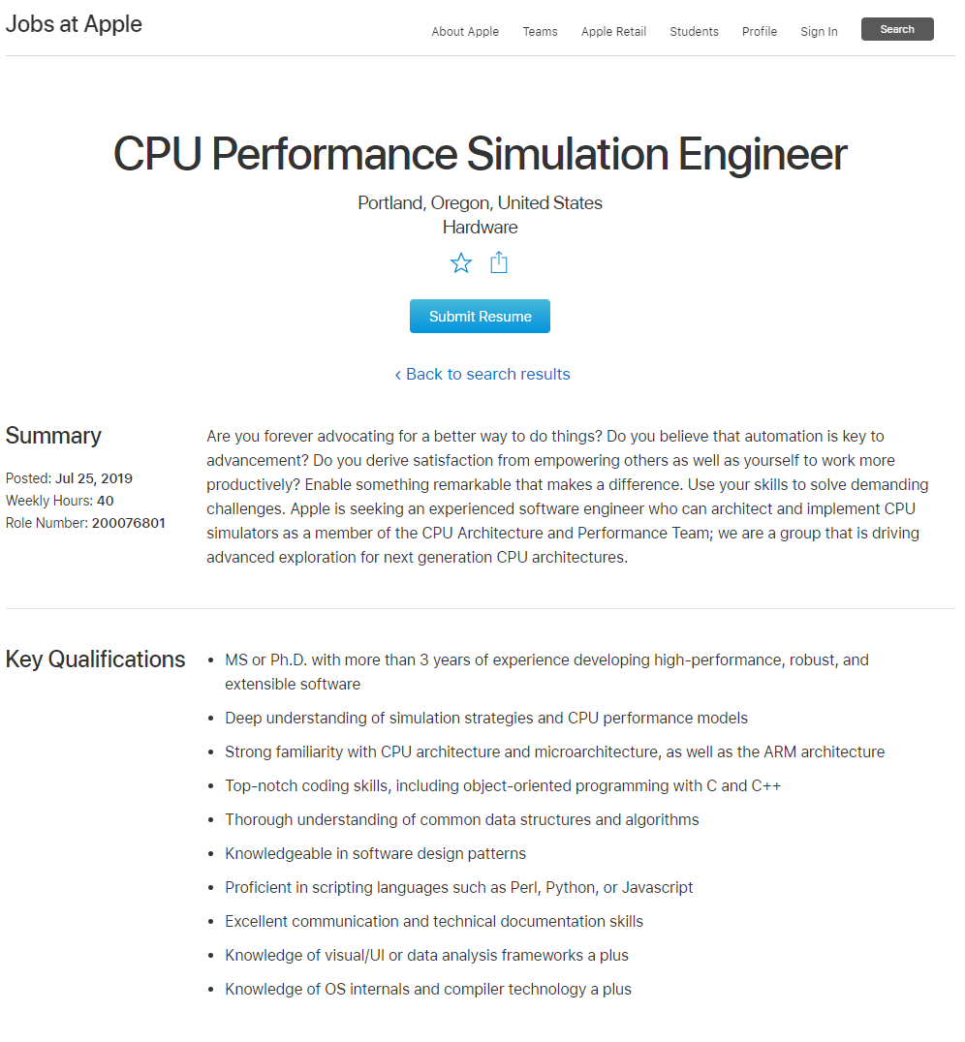
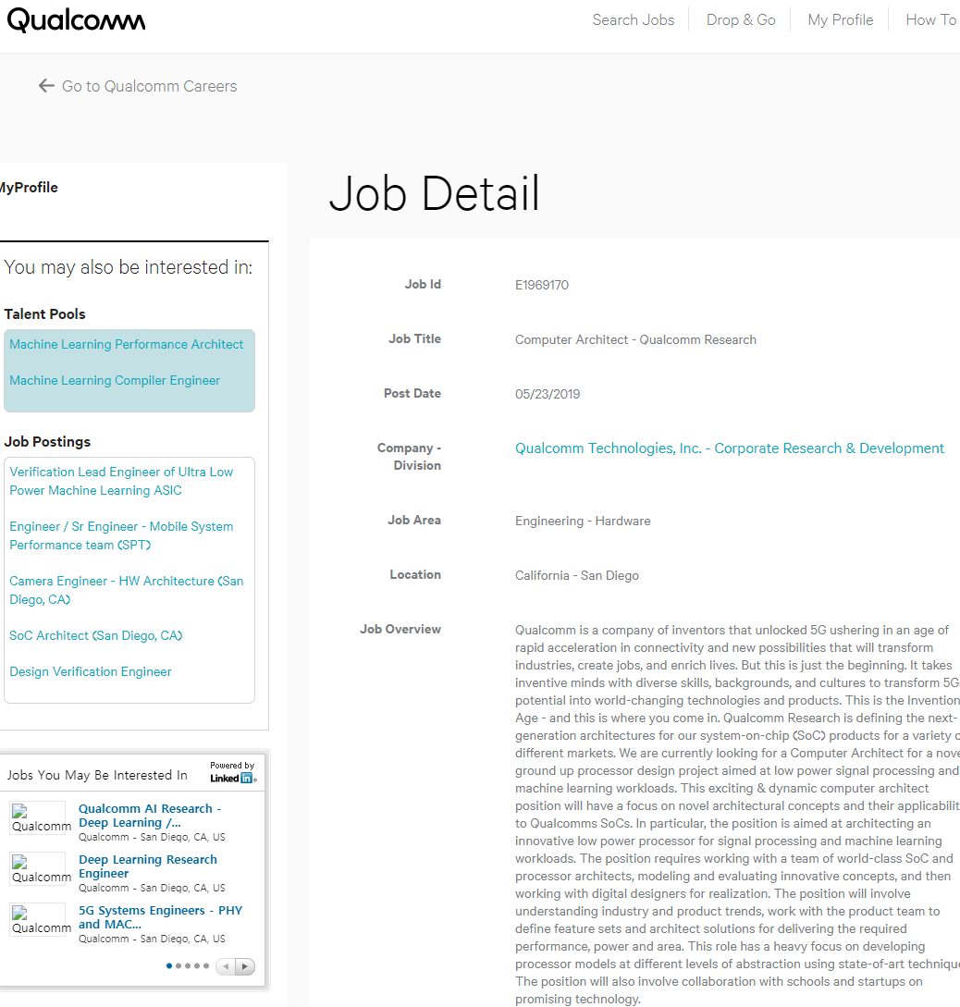
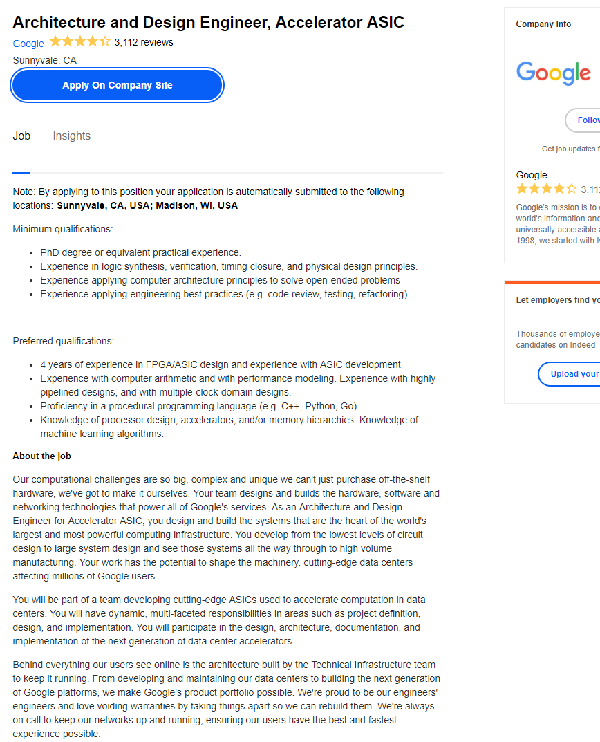
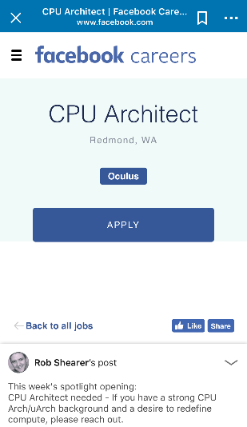




What you can expect from this course?
If you successfully get a great grade from this course,
You will know what architects do and be ready to perform your own simulation-based researches
You will get closer with a better graduation and have a good Ph.D. achievement
>4300 results

Slide 26
Computer Architecture Definition
Bridge application and technology
Application
Gap too large to bridge in one step
➔ Computer Architecture: develop abstraction and implementation layers to execute information processing application efficiently using available fabrication technology
Technology

Slide 27

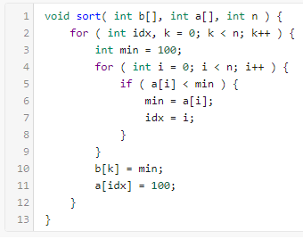
Computer System Stack
Ex) Sort an array of numbers
2,6,3,8,4,5 → 2,3,4,5,6,8
Application
Algorithm
Algorithm
Out-of-place selection sort algorithm
Find min number in array
Move min number into output array
Repeat steps 1 & 2 until finished
Programming Language
Programming Language
Operating Systems
Operating Systems
Operating Systems
Instruction Set Architecture
Instruction Set Architecture
Instruction Set Architecture
C implementation of selection sort
Microarchitecture
Microarchitecture
Computer Architecture
Microarchitecture
Register-Transfer Level
Register-Transfer Level
Register-Transfer Level
Gate Level
Gate Level
Gate Level
Circuits
Circuits
Devices
Devices
Technology
Technology

Slide 28



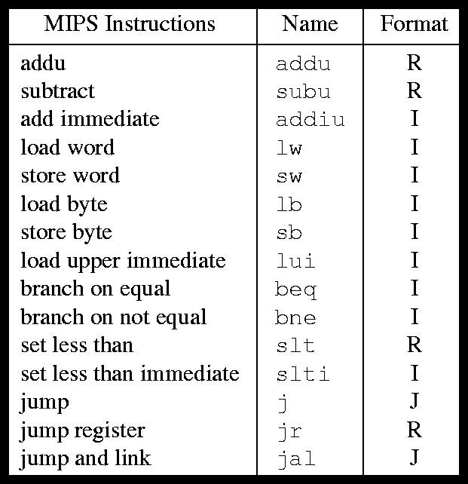
Computer System Stack
Application
Mac OS X, Windows, Linux
Handles low-level HW management
Algorithm
Programming Language
Operating Systems
Operating Systems
Instruction Set Architecture
Instruction Set Architecture
Microarchitecture
MIPS32 Instruction Set
Instructions that machine executes
Computer Architecture
Register-Transfer Level
Gate Level
Circuits
Devices
Technology

Slide 29
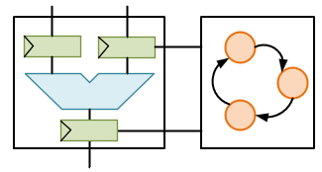
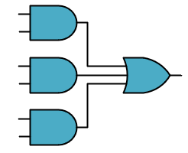
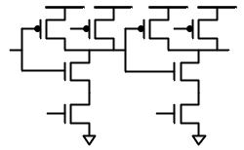
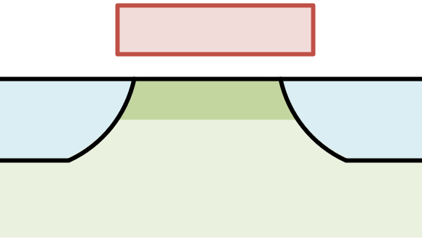
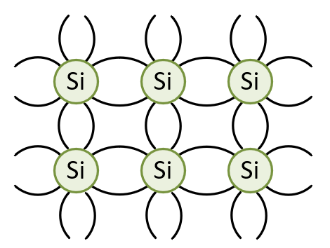
Computer System Stack
Application
How data flows through system
Algorithm
Programming Language
Boolean logic gates and functions
Operating Systems
Instruction Set Architecture
Combining devices to do useful work
Computer Architecture
Microarchitecture
Register-Transfer Level
Gate Level
Gate Level
Gate Level
Transistors and wires
Circuits
Circuits
Devices
Devices
Silicon process technology
Technology
Technology

Slide 30
Logic, State, and Interconnect
Application
Digital systems are implemented with three basic building blocks
Logic to process data
State to store data
Interconnect to move data
Algorithm
Programming Language
Operating Systems
Instruction Set Architecture
Computer Architecture
Microarchitecture
Logic
State
Logic
State
Logic
Register-Transfer Level
Gate Level
Interconnect
Circuits
State
Logic
State
Logic
State
Devices
Technology

Slide 31
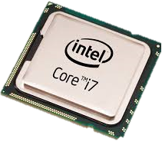
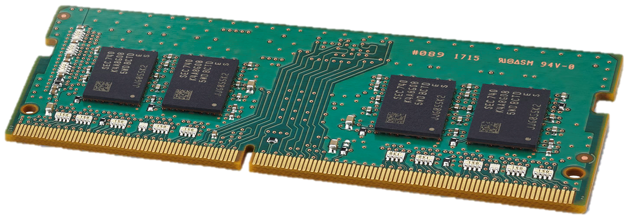
General-Purpose Computing:
Application
Computer engineering basic build blocks
Processors for computation
Memories for storage
Networks for communication
Algorithm
Programming Language
Operating Systems
Instruction Set Architecture
Computer Architecture
Microarchitecture
Register-Transfer Level
Gate Level
Input data
Network
Output data
Circuits
Devices
Technology
Source: Processors, Memories, and Networks

Slide 32

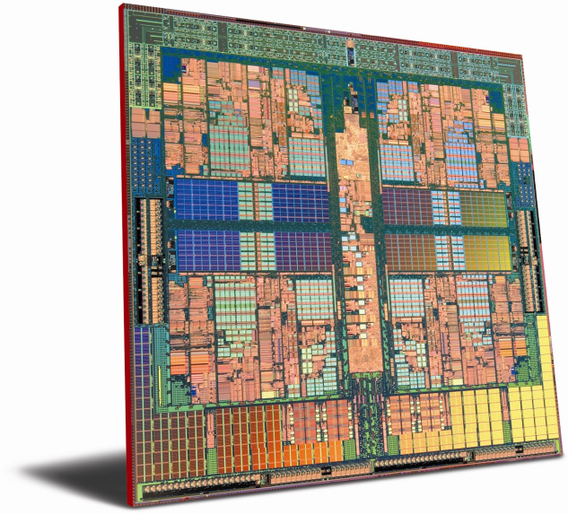





System Research as a Scientific Approach
General Science
Discover truths about nature
Computer Engineering
Explore design space for a new system
Design and model baseline system
Ask question about nature
Ask question about system
Construct hypothesis
Test with experiment
Test with experiment
Analyze results & draw conclusions
Analyze results & draw conclusions
Design and model alternative system

Slide 33
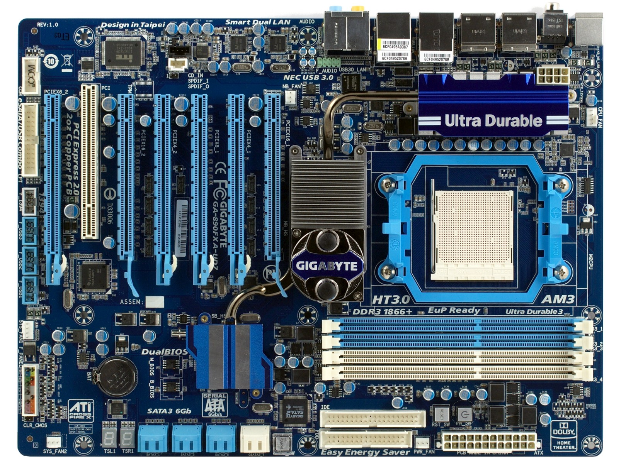
Let’s Look at the Details of Mainboard
PCIx16 slots
PCI slot
North bridge
CPU
socket
USB headers
South bridge
RAM slots
SATA plugs
PATA
connectors

Slide 34
Many different physical socket standards
Physical standard is less important than Instruction Set Architecture (ISA)
IBM PCs are Intel 80836 compatible
Original x86 design
Intel, AMD, VIA
Today’s dominant ISA: x86-64, developed by AMD
CPU socket

Slide 35
Coordinates access to main memory
North bridge
Pre-1993: DRAM (Dynamic RAM)
Post-1993: SDRAM (Synchronous DRAM)
Current standard: Double data rate SDRAM (DDR SDRAM)
RAM slots

Slide 36
Slightly less old standard: PCI slots
(or AGP/PCI-X slots)
Attached to the south-bridge bus
Built in I/O
I/O device slots
Facilitates I/O between devices, the CPU, and main memory
South bridge

Slide 37
Controlled by the South Bridge
Old standard: Parallel ATA (P-ATA)
AT Attachment Packet Interface (ATAPI)
Evolution of the Integrated Drive Electronics (IDE) standard
Other standards
Small Computer System Interface (SCSI)
Serial ATA (SATA)
Storage connectors

Slide 38
L1, L2, L3 Cache
All devices compete for access to memory
CPU(s)
Graphics
Memory
North/South Bridge
Graphics Memory
I/O
I/O

Slide 39
Main Memory
System Bus
CPU
L1 (and L2, L3) Cache
Instruction Fetch
Floating Point
(FPU)
Arithmetic and Logic
(ALU)
Arithmetic and Logic
(ALU)
Registers
Decode
Control Unit

Slide 40
Processor Performance Increase
Intel Pentium 4/3000
DEC Alpha 21264A/667
DEC Alpha 21264/600
Intel Xeon/2000
DEC Alpha 5/500
DEC Alpha 4/266
DEC Alpha 5/300
DEC AXP/500
IBM POWER 100
HP 9000/750
IBM RS6000
MIPS M2000
MIPS M/120
SUN-4/260

Slide 41
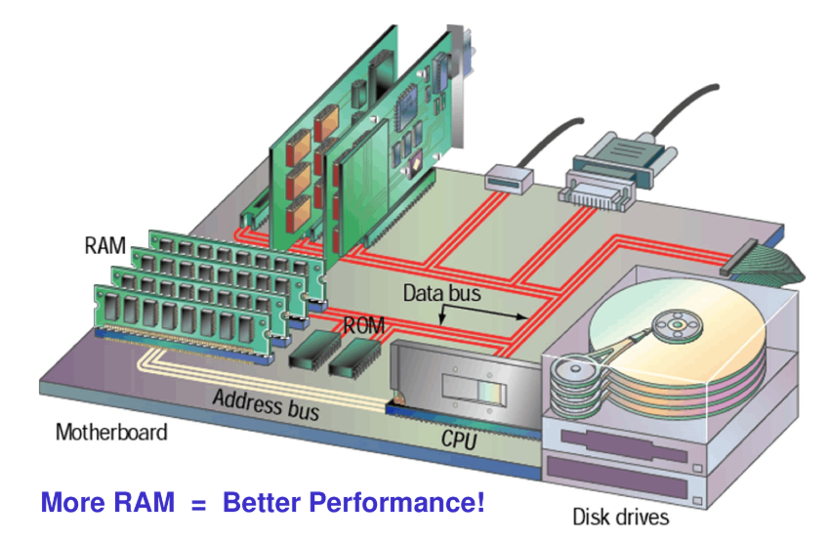
Impacts of Advancing Technology
Capacity: 2x every 2 years
Speed: 1.5x every 10 years
Cost per bit: decreases 25% per year
Capacity: increases 60% per year
Performance : 30% per year
Capacity : 2x every 1.5 years

Slide 42

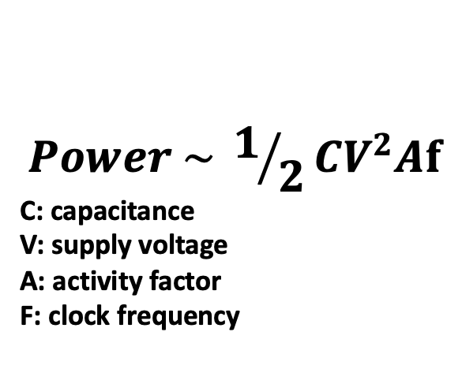
Performance vs. Power Density Trend
10000
$$Power \sim 1/2CV^{2}Af$$
C: capacitance
V: supply voltage
A: activity factor
F: clock frequency
1000
Rocket
Nozzle
Nuclear
Surface of the Sun
100
Reactor
Power Density (W/cm2)
10
8086
Hot Plate
P6
8008
8085
Pentium® proc
4004
286
386
486
1
8080
1970
1980
1990
2000
2010
Year

Slide 43
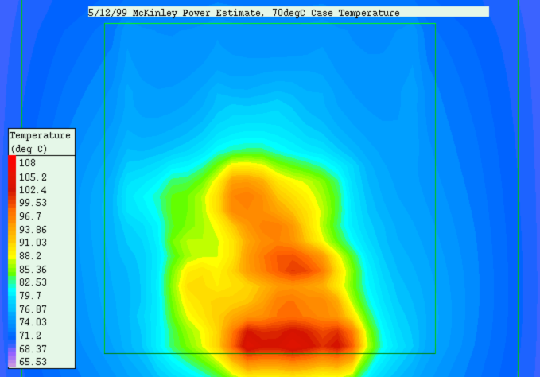
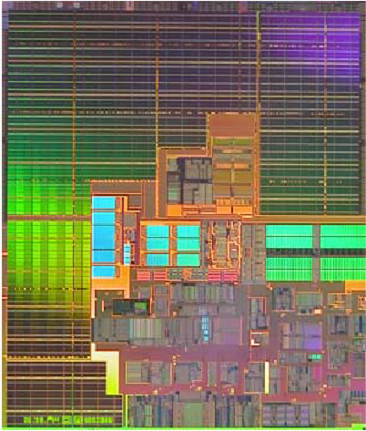
Thermal map: 1.5 GHz Itanium-2
Cache
Temp
(ºC)
Execution
core
120ºC
Source: Intel Corporation and Prof. V. Oklobdzija

Slide 44
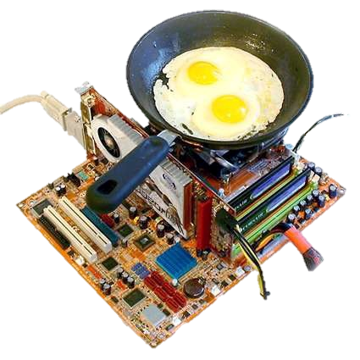
The Result
Getting a higher frequency to follow up the expectation of such a performance trend is non-trivial
Architectural solutions help CPUs get higher performance: we will learn the answers for the below questions

Slide 45
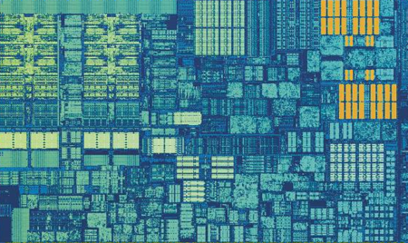
Architectural solutions
How can we improve the performance at a same or similar clock frequency?
How can we schedule instructions to improve the performance over hardware?
L1 D$
Execution Units
L2 CACHE
Instruction Scheduling Retirement
L1 I$
Source: *Die photo credit: Intel WikiChips

Slide 46
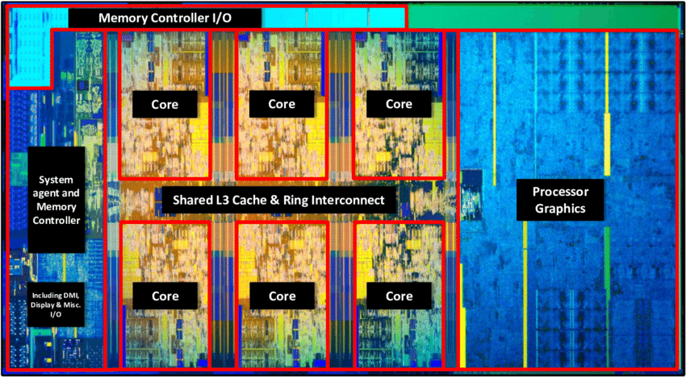
Inside a Modern Processor Chip
Intel Coffee Lake

Slide 47
Multi-Core Systems
How can we inter-connect them cores?
Caches are now shared by multiple cores, how can we make them consistent and coherence?
How can we schedule and synchronize threads across multiple cores?
Do we need to be aware of a cache affinity, imposed by multiple cores?
CORE 0
CORE 1
CORE 2
CORE 3

Slide 48
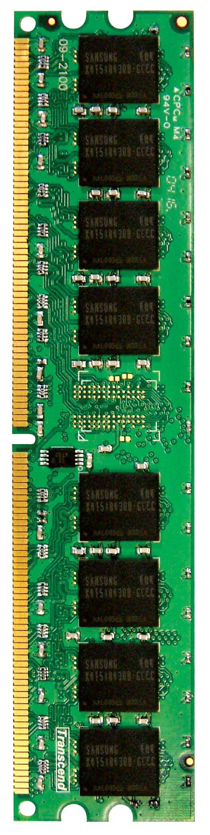
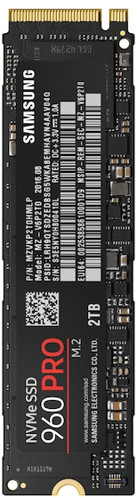
Multi-Core Systems
DRAM are also shared by all of the cores, what do have to handle large memory footprints?
How can we make storage performance follow up and sharable?
PCIe

Slide 49
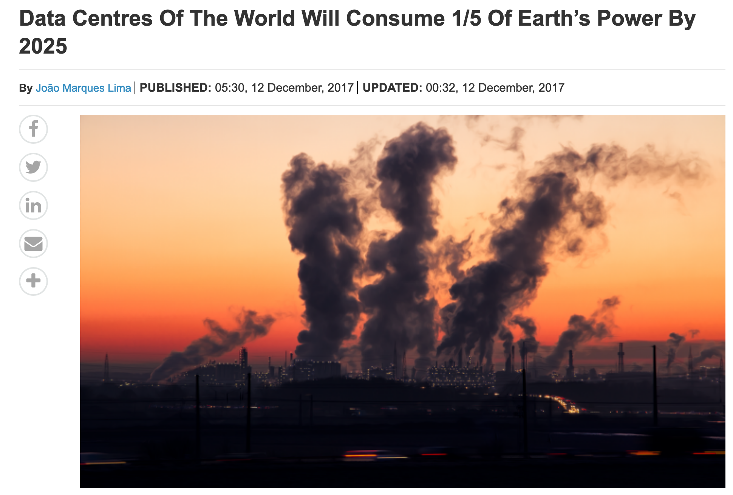
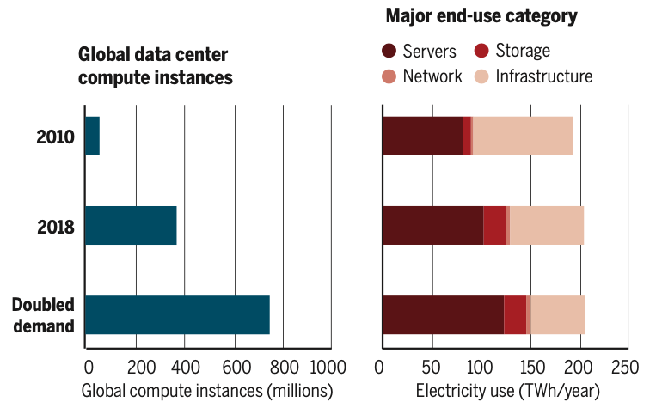
Energy Consumption Issue of Datacenters
Real growth is much slower* (2010-2018)
550% increase of compute instances
6% increase of electricity usage
550%
6%
*Masanet, Eric, Arman Shehabi, Nuoa Lei, Sarah Smith, and Jonathan Koomey, 2020,
Recalibrating Global Data Center Energy-Use Estimates. Science 367(6481): 984–986.
Notes:
Datacenter consumes about 1%-2% total electricity usage of the world
As the datacenter capacity and computation/storage/network usage increase rapidly. It was predicated to consume 1/5 earth power by 2025
However, the real growth is much slower. 550% increase of compute instances, only 6% increase of electricity usage
Why?

Slide 50
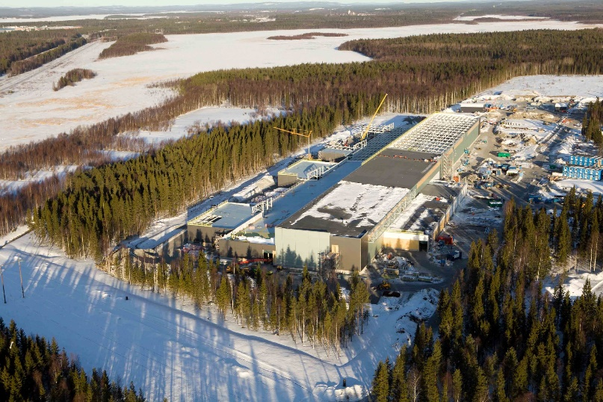
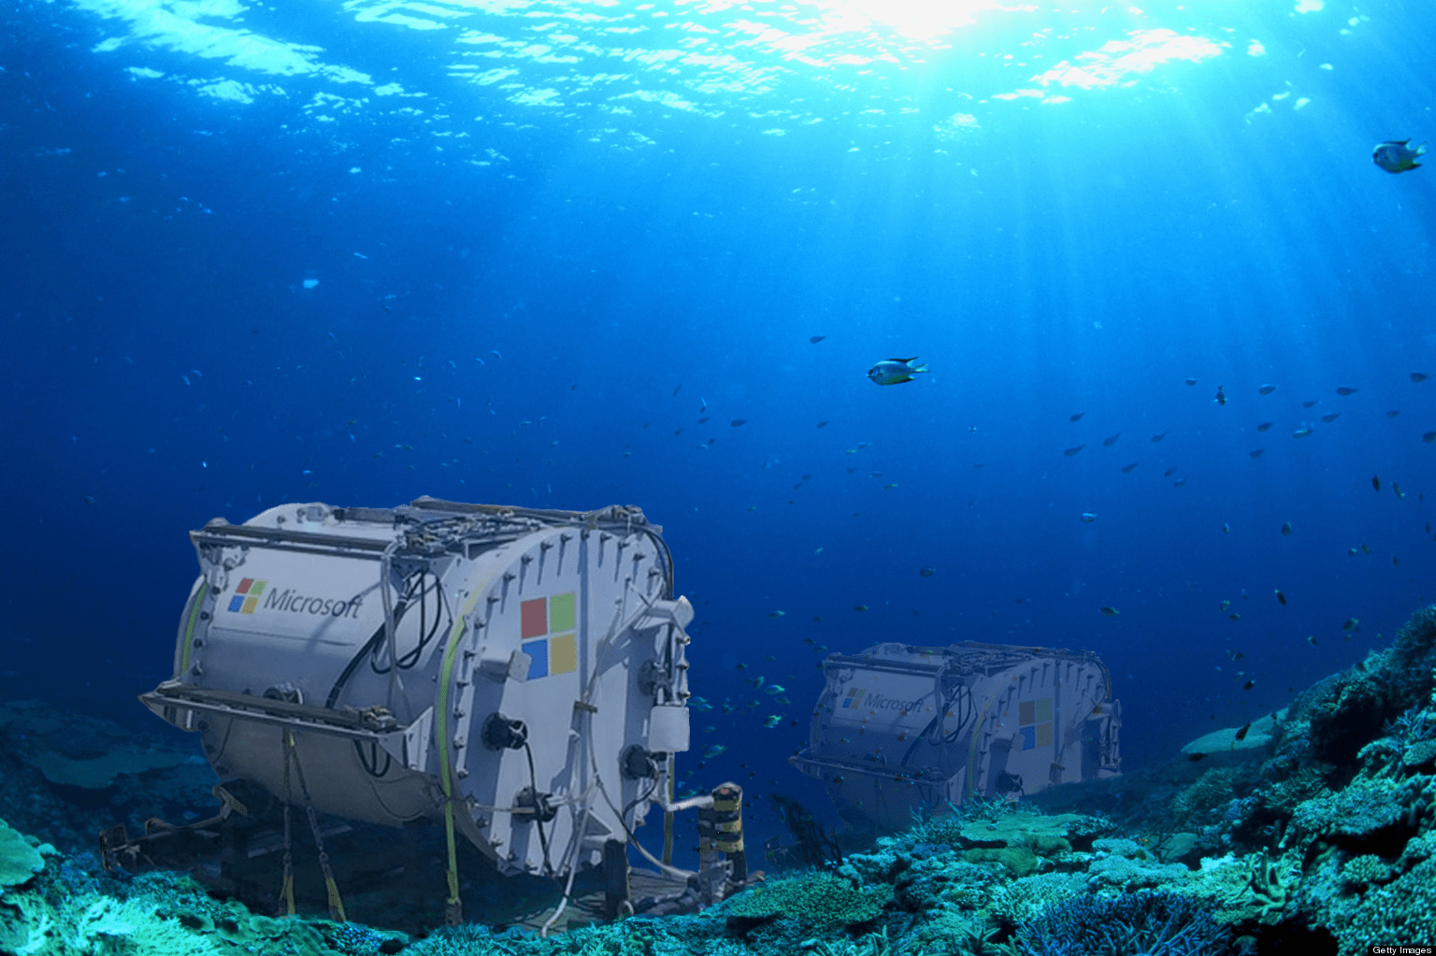
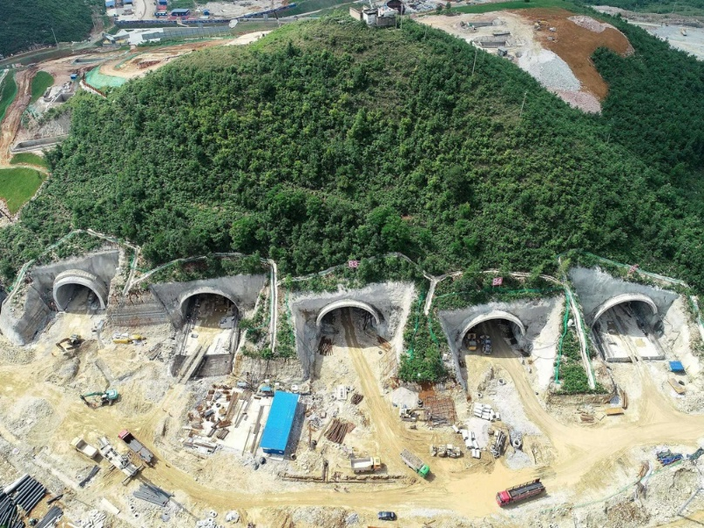
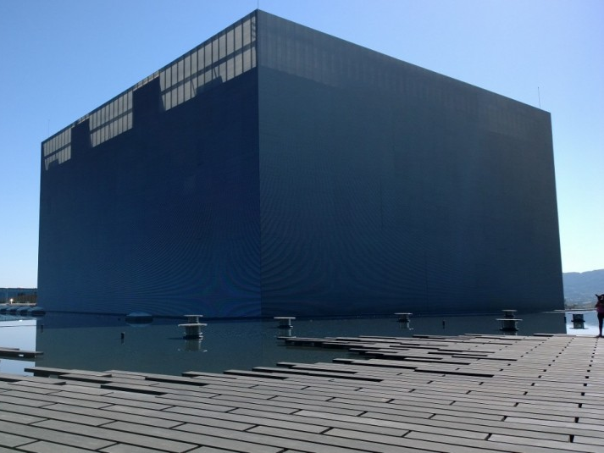
Thermal Consideration

Slide 51
Techniques Improve Energy Efficiency
GPU
FPGA
Heterogeneous
Computing
Accelerator
Transistor Technology Improvement
Energy
New Storage Devices
Virtualization
Cooling
Notes:
PUE in large datacenter is much better than the local server/small datacenter
Moving computation to cloud is more energy efficient

Slide 52
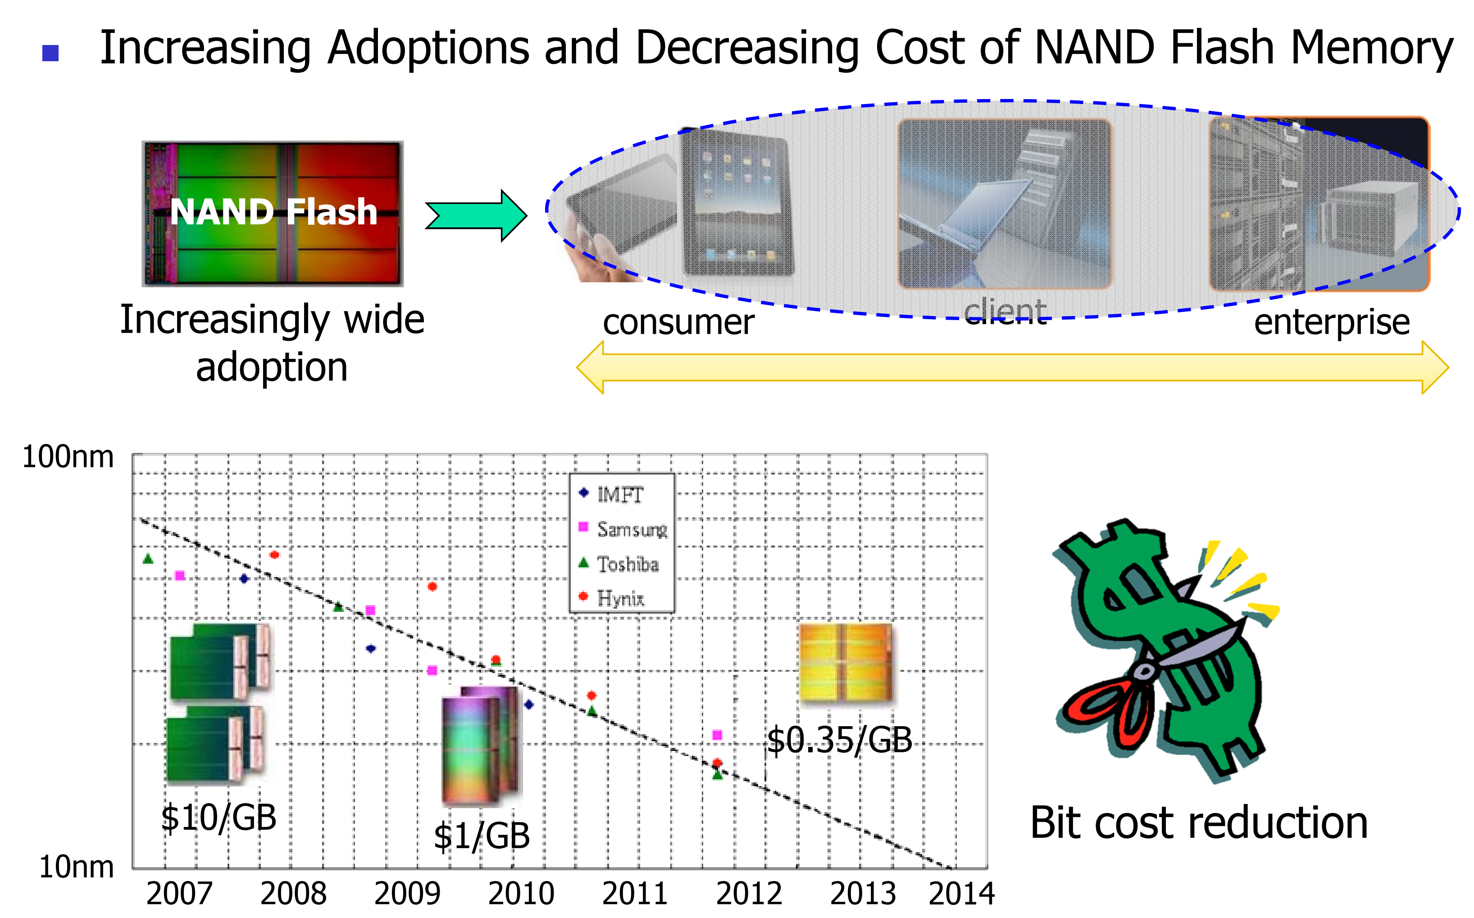
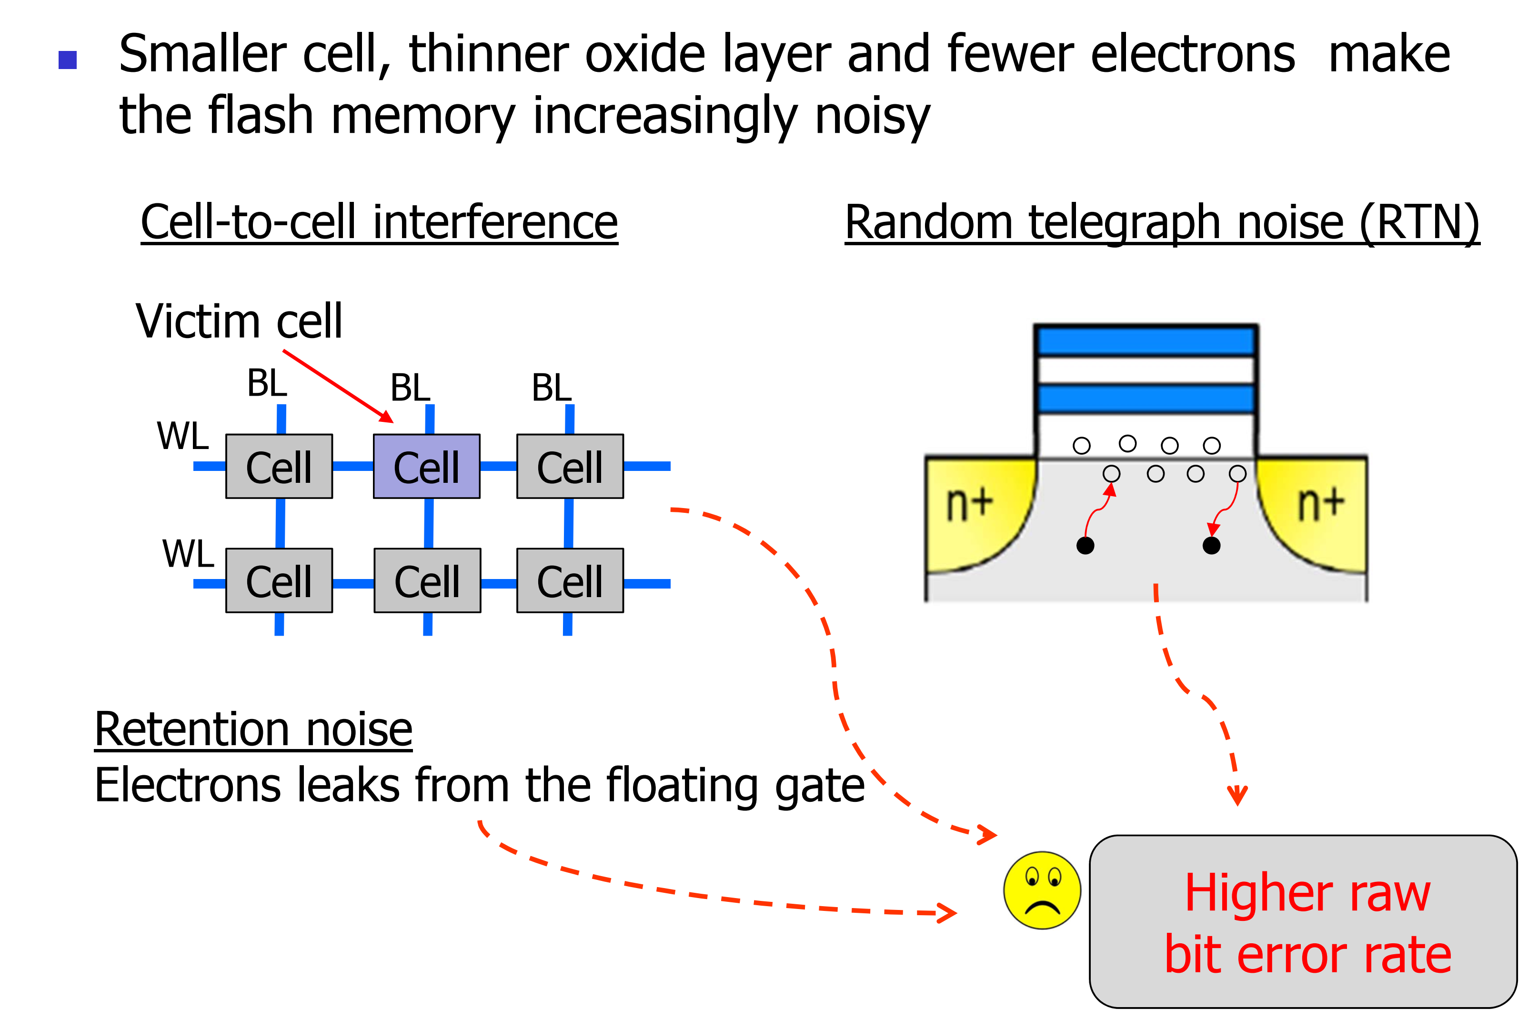
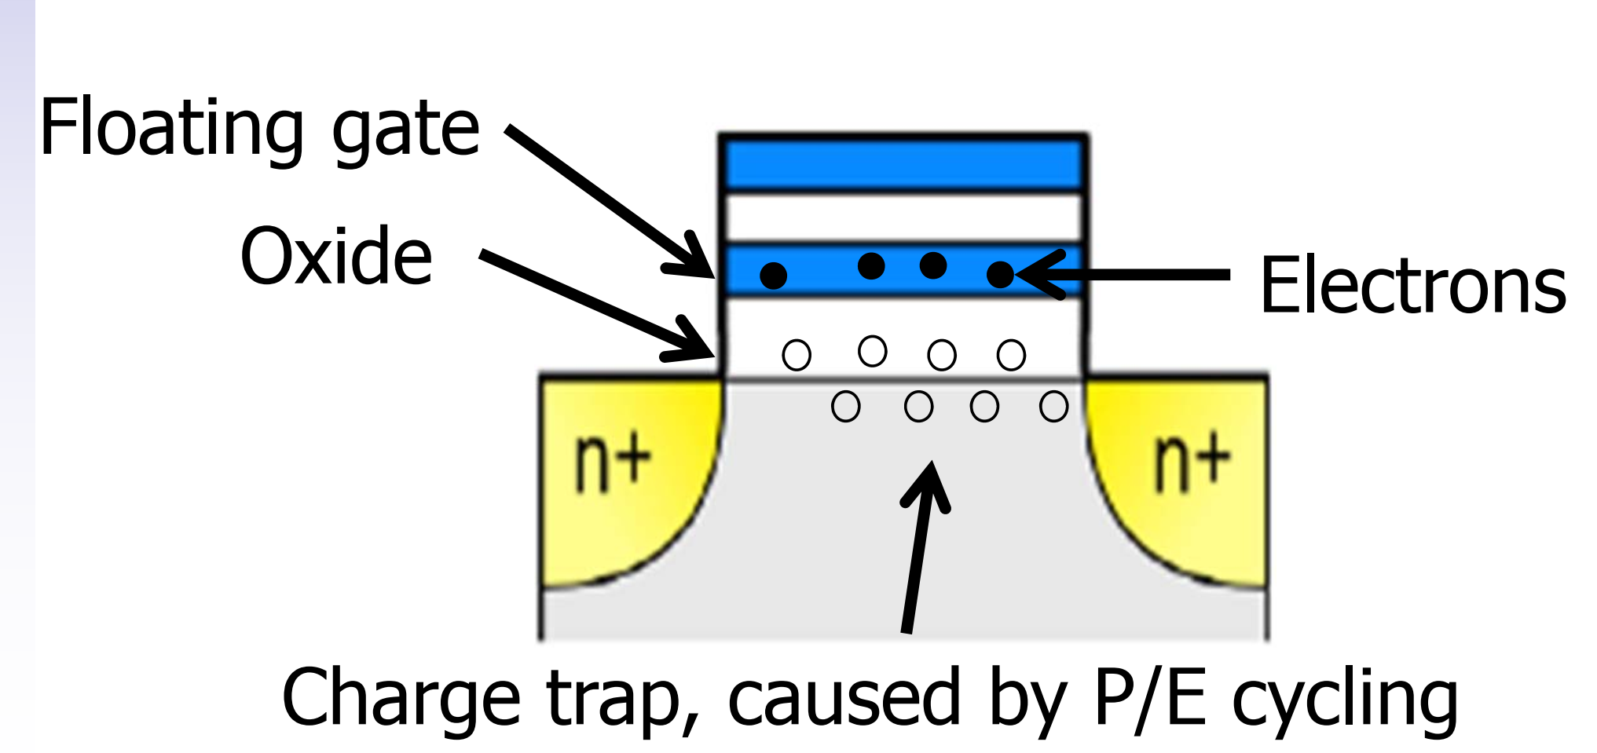
Reliability Issue Example: SSD

Slide 53
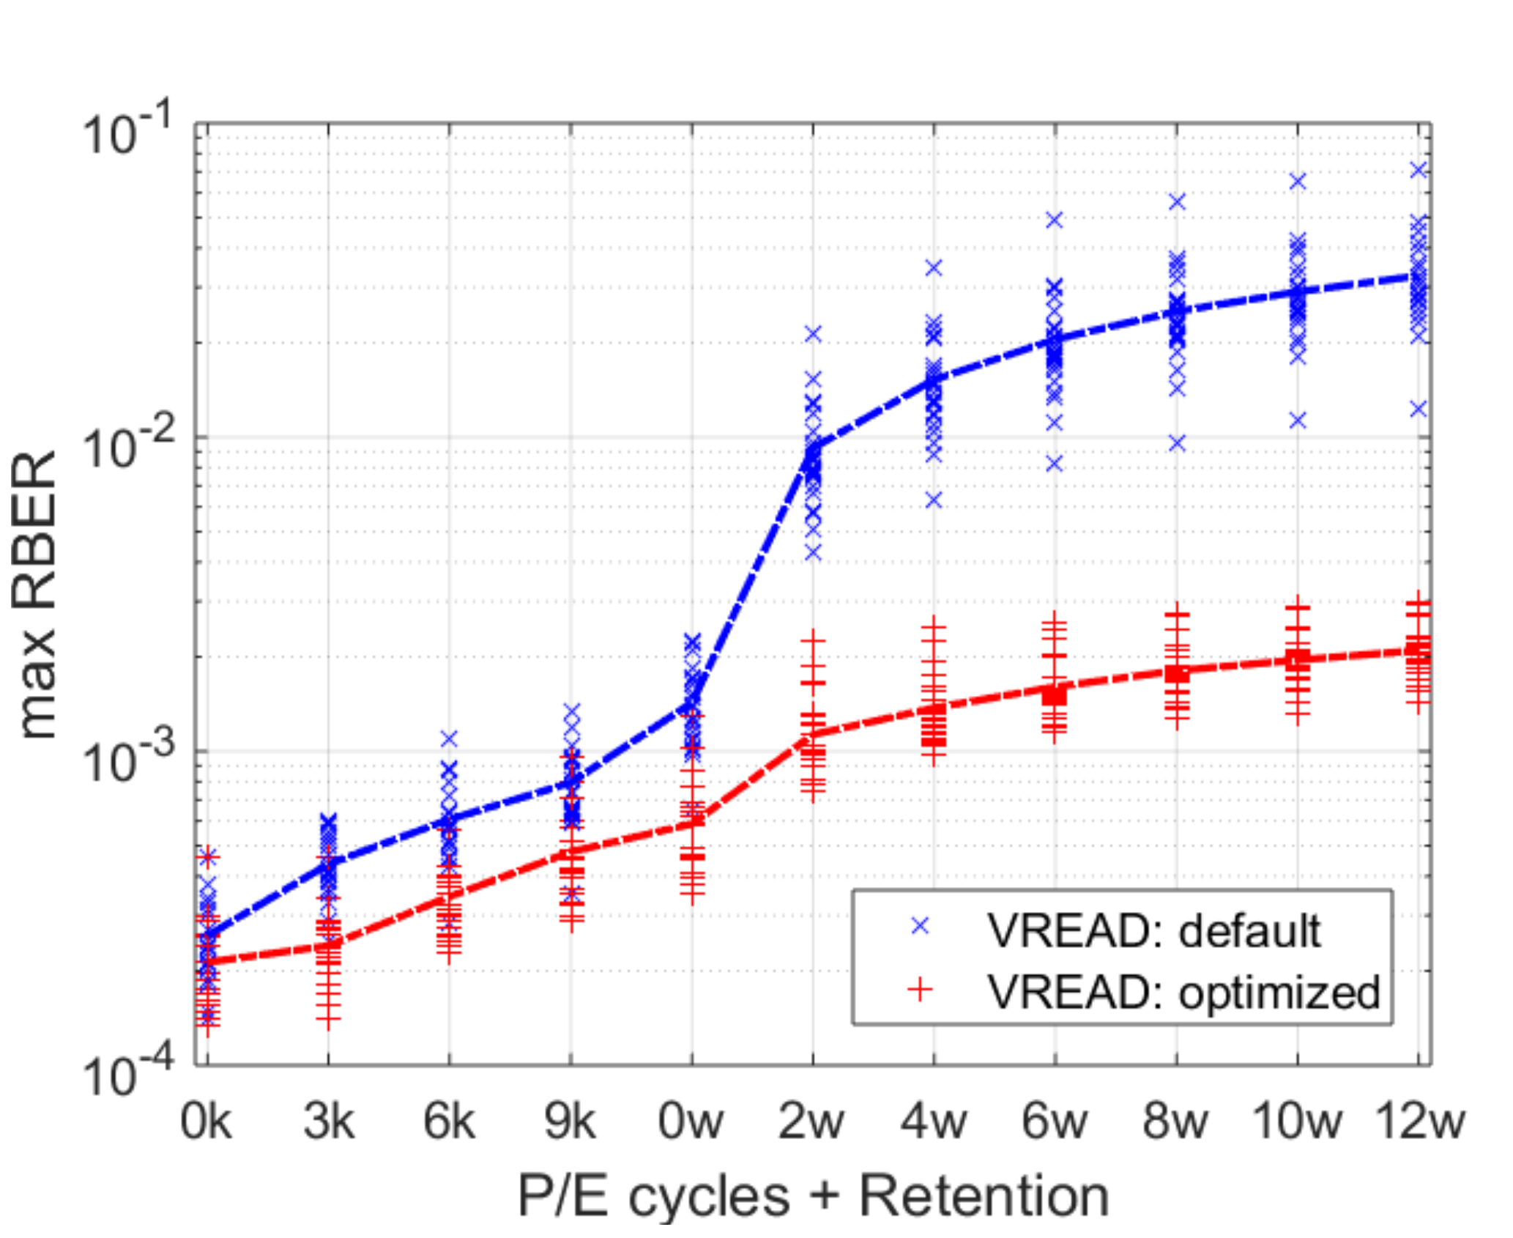
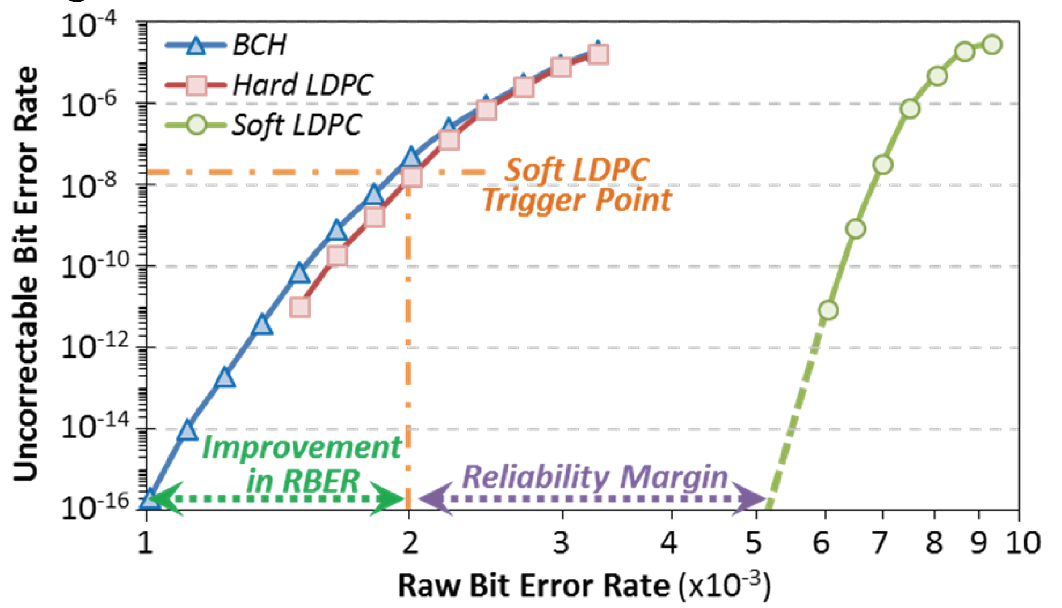
Error Correction Code (ECC)

Slide 54
Next Lecture and Reminders
Next lecture
ISA & Algorithm, P&H, Chapter 2 & 3

